Slide 1
Introduction to
ArcGIS automation through scripting with Python

Slide 2
Who are you?
UG
Post doc
PhD
Ecologist and part-time physical oceanographer, experienced in most marine habitats, particular expertise with engineering species (corals, sponges, macroalgae).
Multidisciplinary, computationally and technically minded, specializations in spatial analysis, statistics, data visualization and data acquisition.
International research experience, many studies conducted collaboratively with colleagues from around the world.
Dedicated to Open Source, Open Access and Open Data movements.
Faculty
Since August 2018

Slide 3
28
5

Slide 4
Deaf awareness
I was hearing impaired since birth and during the last 10 years am now profound. This is caused by my nerves in my ear not working correctly.
I have a cochlear implant which gives me an excellent level of hearing (albeit, computer generated), I am a good lip reader too.
Couple of tips:
If you call out, I might not hear (and I have no directionality in hearing), so make sure you attract my attention visually.
Try to speak clearly but don’t feel that you have to change the way you speak, just be normal.
Don’t be afraid to repeat what you said if I miss it or go off on a tangent (I sometimes mishear), sometimes people get embarrassed if having to repeat several times. Don’t worry, eventually I will get it.
Don’t sneak up on a deaf person, always approach from the side so I can see you first before you touch me. Can be very shocking.

Slide 5
Course goals
Expose you to the Python programming language and provide opportunity to practice using basic functionality.
Introduce arcpy and how this can be used to automate and extend geoprocessing tasks.
Provide you with the skills needed to successfully develop Python tools that can be used, not only by yourself, but external users.
Provide practice in the use of Github as supplementary tool for code dissemination and storage.

Slide 6


Slide 7
What is Python and why use it?
Python is an interpreted, object-oriented, high-level programming language with dynamic semantics. Its high-level built in data structures, combined with dynamic typing and dynamic binding, make it very attractive for Rapid Application Development, as well as for use as a scripting or glue language to connect existing components together. Python's simple, easy to learn syntax emphasizes readability and therefore reduces the cost of program maintenance. Python supports modules and packages, which encourages program modularity and code reuse. The Python interpreter and the extensive standard library are available in source or binary form without charge for all major platforms, and can be freely distributed.
Often, programmers fall in love with Python because of the increased productivity it provides. Since there is no compilation step, the edit-test-debug cycle is incredibly fast. Debugging Python programs is easy: a bug or bad input will never cause a segmentation fault. Instead, when the interpreter discovers an error, it raises an exception. When the program doesn't catch the exception, the interpreter prints a stack trace. A source level debugger allows inspection of local and global variables, evaluation of arbitrary expressions, setting breakpoints, stepping through the code a line at a time, and so on. The debugger is written in Python itself, testifying to Python's introspective power. On the other hand, often the quickest way to debug a program is to add a few print statements to the source: the fast edit-test-debug cycle makes this simple approach very effective.
https://www.python.org/doc/essays/blurb/

Slide 8
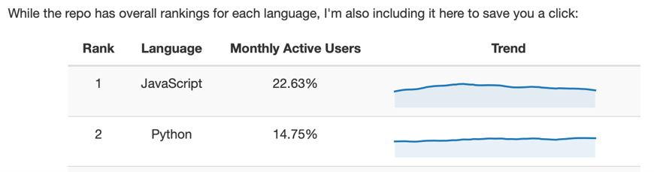
What is Python and why use it?
Just to reiterate:
Easy to read code.
Supports modules and packages (e.g. arcpy).
Free and open source.
Python increases productivity.
Easy edit-test-debug cycle:
Ideal for new programmers and those that are casual code users.
Vastly popular:
#2 On Github for repos.
Lots of code snippets on the internet
https://www.benfrederickson.com/ranking-programming-languages-by-github-users/

Slide 10
What is ArcGIS and why use arcpy?
ArcGIS has been developed over several decades.
Prior to this, we had:
Arc/INFO workstation
ArcView 3.x desktop
Released in 1999, ArcMap 8 was released.
GUI and had some geoprocessing power, but no real environment to work with spatial data in a command line/programming environment.
Strengths are the GUI, Toolboxes, ModelBuilder (introduced in ArcMap 9), standards and extensions (Spatial Analyst, 3D analyst).
Version 10 introduced the arcpy package (can be shown as ArcPy).
Game changer for GIS programmers.
Allows us to interface with other packages.
Rarely need the GUI for any reason but to view/check data.

Slide 11

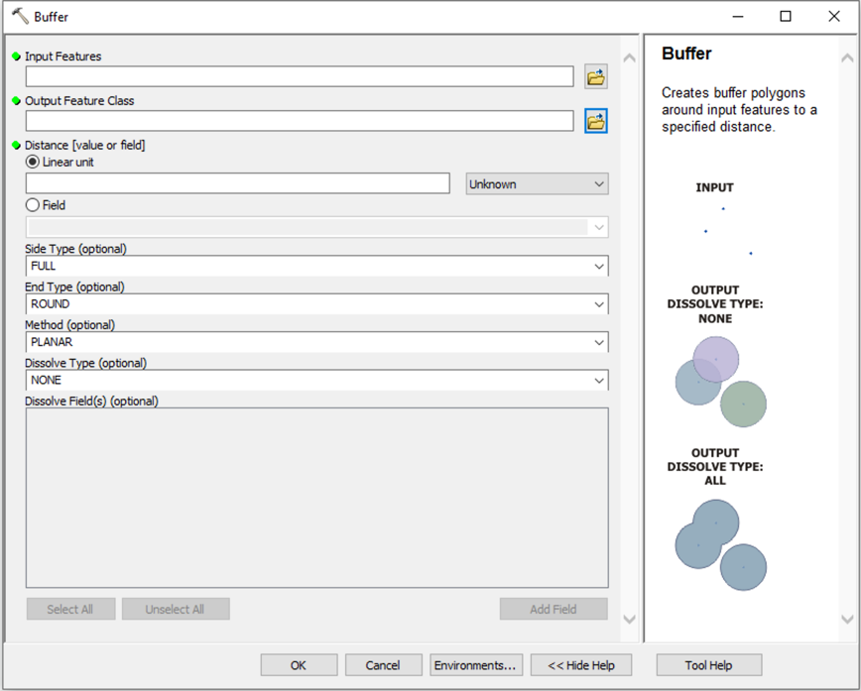
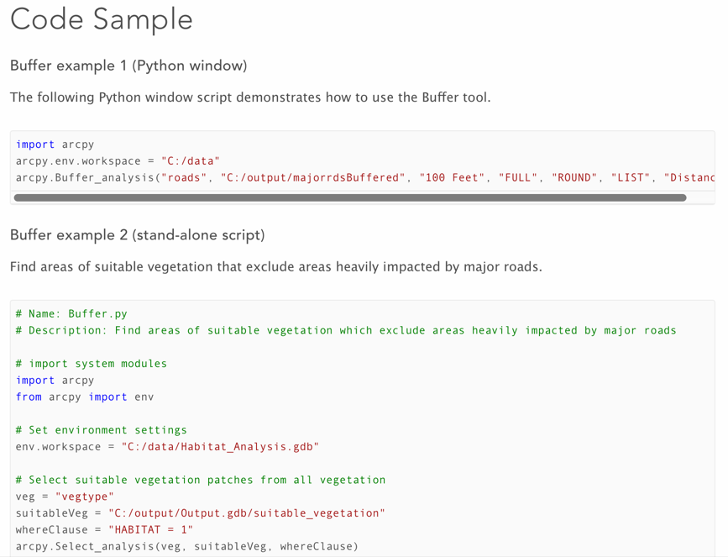
The Buffer Tool in ArcGIS

Slide 12


Slide 13

What is Git and why use Github?
Github is a code hosting website that uses the version control system Git, which was originally created by Linus Torvalds.
Git allows you to create versions, most simply through committing changes to a database.
Allows you to revert back if you make a mess.
Can also be used for collaboration/dissemination of your work.
Has bug/issue tracking and reporting system.

Slide 14
What is Git and why use Github?
Centers around “repositories” aka “repos” which hold your files in a structured manner.
Students (and just announced, now anyone) can have unlimited private (as well as public) repositories.
Private repos are only shared with your collaborators. Useful for crude (and embarrassing code that you don’t want to share).
Public are viewable and interactable by everyone.
It is not just for hosting code, can be for practically anything!
www.github.com

Slide 15
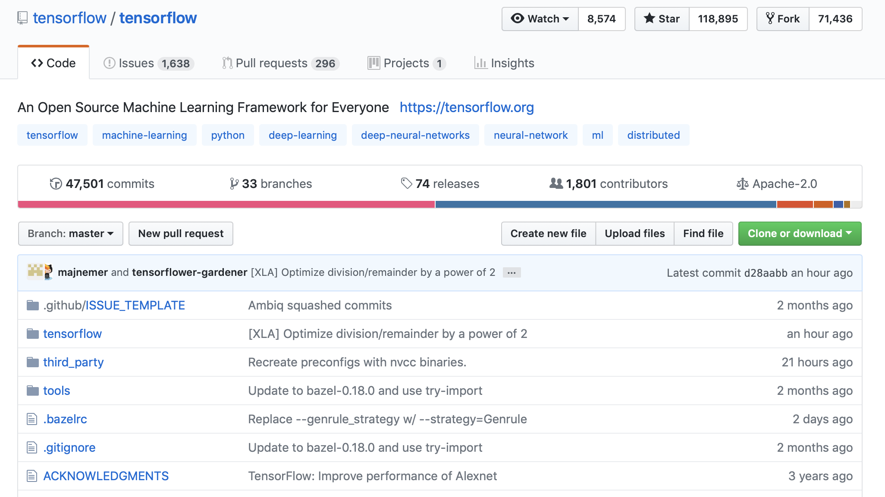
Notes:
1. Account name, plus slash and repository name.
2. Watch = People following bug fixes, commits etc. Star = like/thumbs up, not much tracking. Fork = creates a copy of the current repository that can be edited by yourself.
3. Issues = Reported issues, and bug tracking system. Pull requests = When you make a change, and are not a “committer”, you can suggest code changes that can be merged into a branch. Projects = Kind of a project management system that allows you to set up goals etc.
4. Commits = The changes that you make to the repository, i.e. you make some changes locally and then “commit” the change to the repository.
5. Branches = You may want to create a new branch to test out new features or experiment with a new idea. All without wrecking your main repository.
6. Releases = You can package up a “release” of your code, i.e. as an executable, zip file etc that would “lock” in your code at a certain time. I use releases when I have finished a paper, and use the release as an archive of the code status at the time of publication.
7. Contributors = If you have others working on your code, you may invite contributors.
8. License Type = You can select a license to protect your code if you wish, there are lots of them.
9. Branch selector = You can change branches here.
10. Pull request = You first make a branch, do your changes, and then you can submit a Pull request which will allow other contributors to to discuss the changes and potentially merge the changes into the main branch.
11. Clone or download = Most people will just download your code for review.
12. This is where your files/code are stored.

Slide 16
How will we run the class?
Syllabus and Schedule

Slide 17
Where is the syllabus and course material?
I will regularly commit course materials to the Github Repository:
https://github.com/marecotec/Course_ArcGIS_Python
https://bit.ly/2Mpstgv
As this is a new course, materials will be added weekly, so you should at least Watch or Star the repo on Github.
Scan if
you can

Slide 18
What will we cover?
!
New course, so we may have to change the content as needed. Check Github!
Here
Jan 25 1. Introduction: Overview of different assignments for this class. Set up Github accounts. 2. Interacting with Python: The different Python environments and ways to interact with Python through ArcGIS (and not) – Python.exe, bat files, just clicking on a .py file, geoprocessing command line, PyCharm, toolboxes (.pyt and traditional).
Feb 1 3. Python basics: Commenting, import statements for packages, variables and data types (str, int, float, lists, tuples, dictionaries). Iteration using: for loops, if/elif/else statements, while statements. Code cleanliness (indentation using tabs/spaces, spotting indentation errors), Using Functions to block code. Zero-based indexing.
Feb 8 4. Python modules: Cover modules such as os, sys. Basic file and system manipulation.
Feb 15 5. Arcpy module: Present basic arcpy functionality, where can you find scripts and information, cover basic functionality. Setting environments within arcpy.

Slide 19
What will we cover?
Feb 22 6. Building basic scripts: Cover basic coding tasks, and introduce error handling, print statements and various messaging functionality.
Mar 1 7. Building your first big script by cheating: Using ModelBuilder and ArcToolbox to export python scripts. Extending exported python scripts.
Mar 8 8. File handling and input to arcpy: How to interact with and code input for tools that are available through arcpy. Set Tool Challenge assignment.
Mar 15 Spring break, no classes
Mar 22 9. Functions: Avoid repeating code using functions.
Mar 29 10. Cursors and Table Manipulation: Selecting, searching, iterating through and updating tabular data.

Slide 20
What will we cover?
Apr 5 11. Geometry objects: Programmatically creating geometry objects, points, lines and polygons.
Apr 12 12. Raster manipulation: Creating and working with raster datasets in arcpy.
Apr 19 13. Python Toolboxes: Pythonizing your toolboxes to provide usable interactive toolbox scripts all within a single python file.
Apr 26 14. Designing scripts for others: Building scripts that can be used by others, open source licenses to protect you and your code and dissemination through Github.
!
I am open to construct sessions based around real-world problems that you are having, so communicate these to me. I would love to be able to tailor the sessions, data examples and code examples to individual and group needs. Especially as much of my data would be marine-based.

Slide 21
Assignments
Assignment | Weighting | Set | Due
Attendance | 10% |  | End of term
Coding challenges | 40% | Each week | Each week
Tool challenge | 25% | Session before Spring Break | Session after Spring Break
Python Toolbox | 25% | Session after Spring Break | End of term
I use a categorical
marking scheme
Column adds up to 100% of your grade

Slide 22
Attendance
Attendance is critical to your success in this class.
To earn full credit, you must attend and participate in each class.
If you have an emergency, you are ill, or you have an absence covered under the University policies (i.e. Holy Days, University Sanctioned Events) you are expected to contact the instructor in advance of class.
Flu-like symptoms, contact the instructor and stay home to minimize transference of the virus. Unexcused absences will result in a lower course grade.

Slide 23

Coding challenges (several)
!
I am new to Github Classroom, so expect the odd issue here and there. We will have fall back submissions, such as “email me direct”, ”show code in next class” etc. No one will be penalized for any external issues.
Each week we will undertake a coding challenge based upon covered content.
These challenges will be achievable in a relatively short time (my expectation is an hour or two of work) and submitted for code review through Github Classroom.
The purpose of this assignment is to give you direct and guided practice with Python and arcpy.
Grading and feedback will center around, cleanliness of code, functionality and appropriate use of comments.
Start here

Slide 24
Tool challenge (just once)
In this assignment, you are instructed to produce a small tool that takes advantage of arcpy and Python.
You will need to provide example data, and the code should run on all PC’s.
The tool needs to manipulate a dataset across three different processes, for example, extracting, modifying and exporting data.
The exact workflow is entirely up to yourself. You are expected to take 3-4 hours on this coding assignment, and you should deposit your code and example files within a Github repository for feedback and grading. The criteria are: cleanliness of code, functionality, appropriate use of documentation and depth of processing operation.

Slide 25
Python Toolbox (just once)
In your final assignment for this course, you should create a Python Toolbox that contains a minimum of three simple tools for undertaking geoprocessing and file management operations.
These tools can be discrete or part of a larger workflow. However, the caveats are that you should create a "single file" toolbox (no includes, or external file tools) and not exceed 2000 lines of code in its entirety.
You should document the toolbox using Github README.md, and provide example data for running each of your tools. Grading and feedback will focus on: 1) Does the toolbox install and the tools run successfully?, 2) cleanliness of code, 3) functionality and depth of processing operation, and 4) appropriate use of documentation.

Slide 26
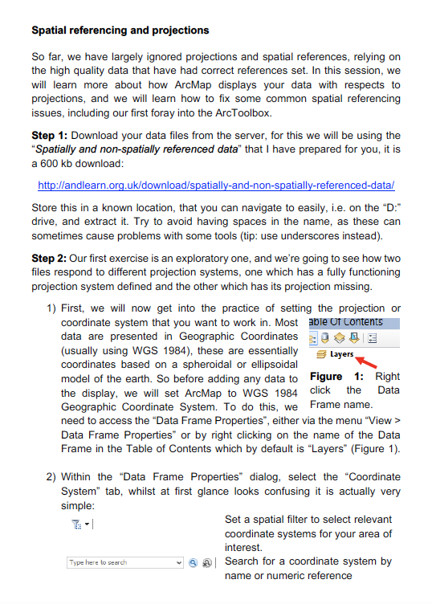
How I layout materials
Example!
To create workflows, classroom assignments etc, I use Microsoft Word. I deeply apologize for this! But I save the file as both a Word Doc (*.docx) and a PDF (*.pdf).
Why?
Easy to layout, share and print.
I can make changes pretty quickly.
Negatives code formatting a pain.

Slide 27
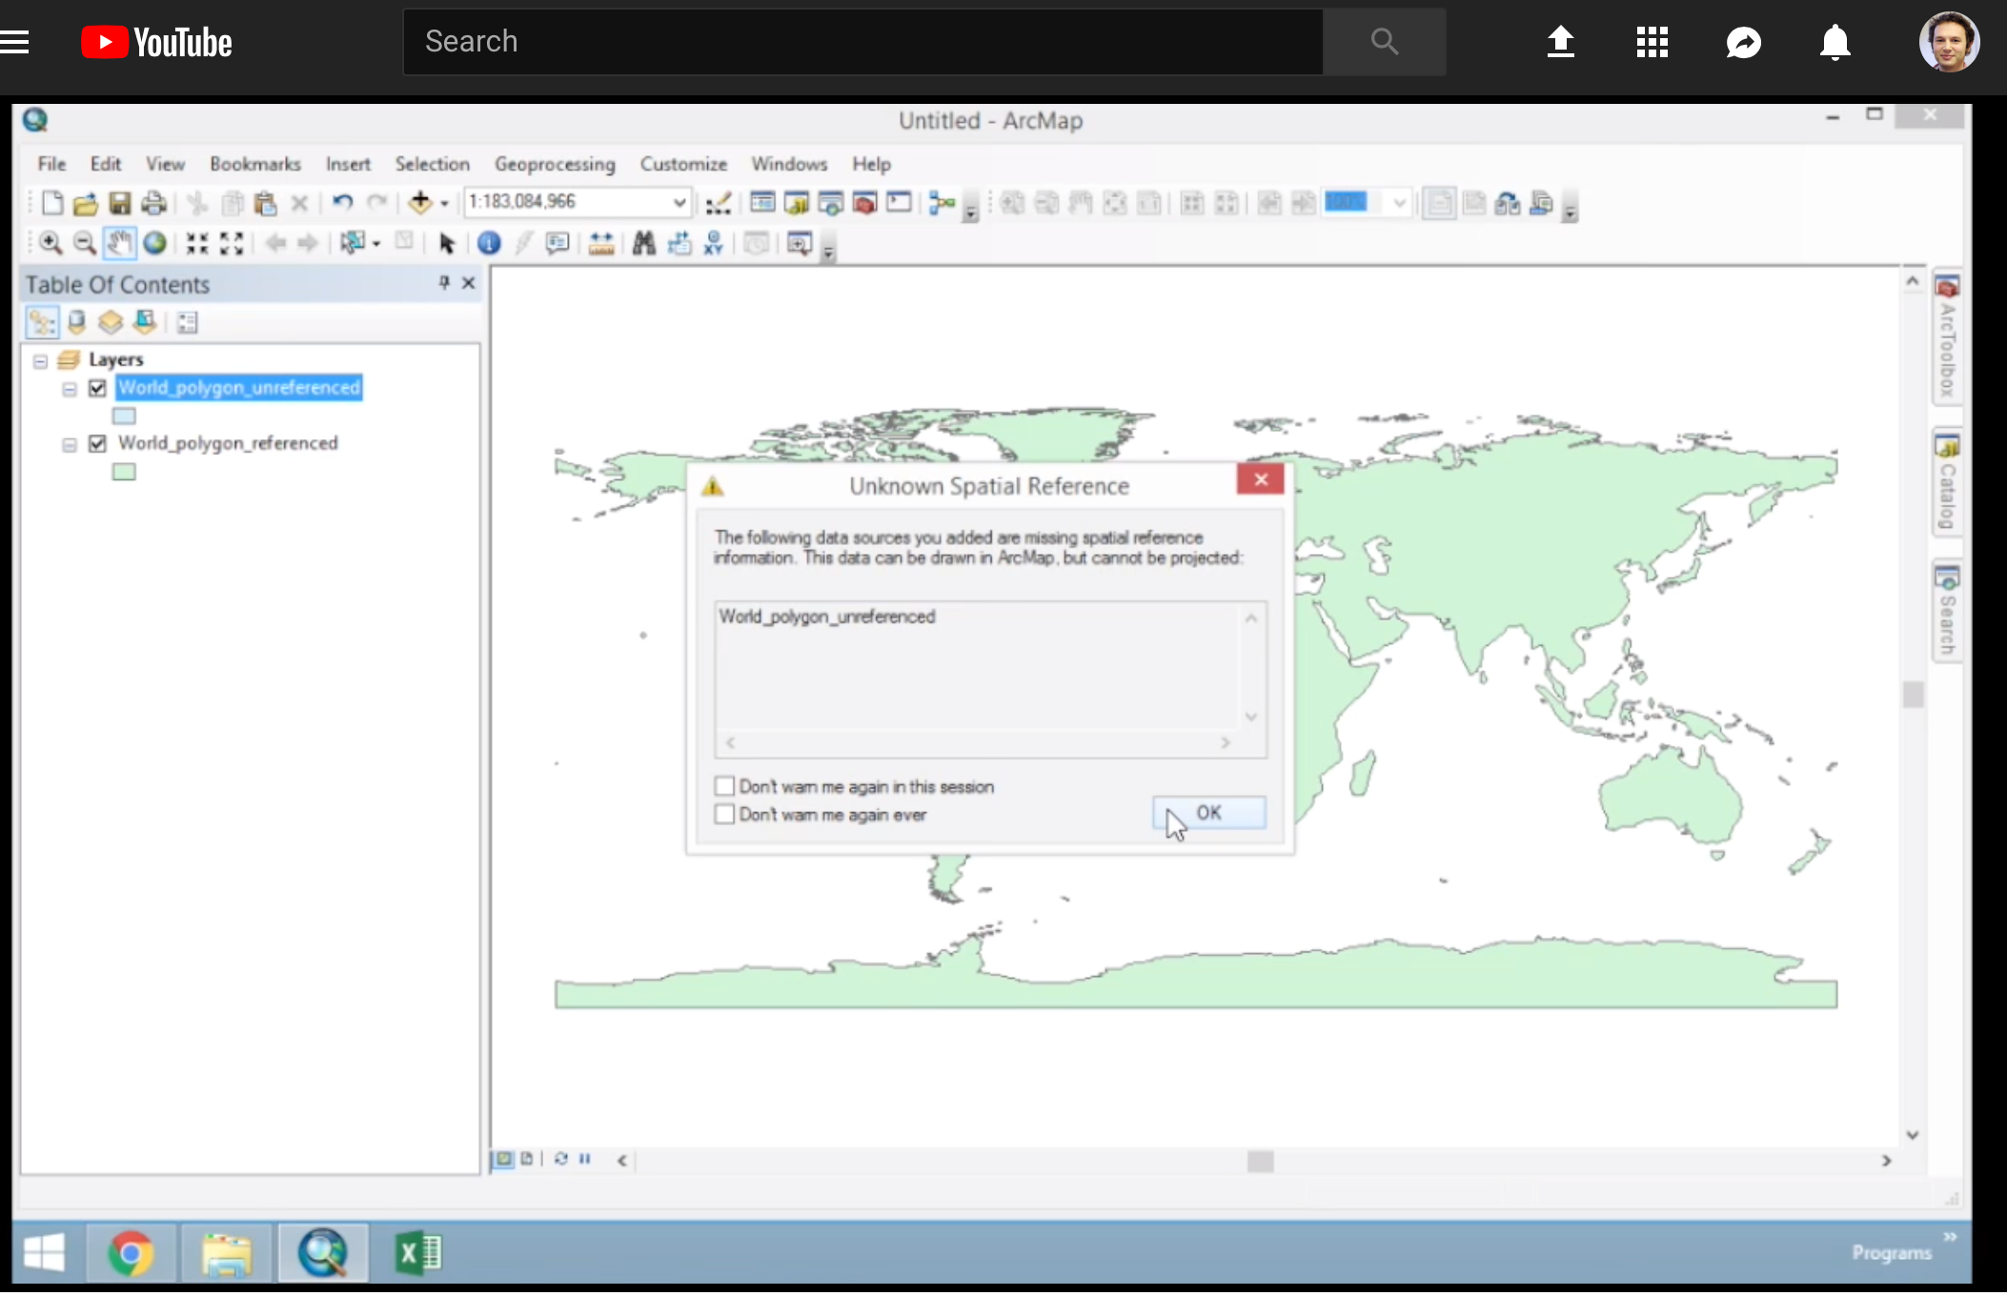
YouTube videos
To support workflows, I try to make screen-cast videos that you can follow in your spare time.
These can be a revision aid, or a way for you to catch up on a class.
Due to the nature of the class, being so new, I expect that I will mostly be making videos after class (once I have tested the material and worked out the bugs).
Videos will be posted on Github, likely in
README.md, maybe in raw compressed
format.

Slide 28
Office hours and my teaching ethos
As a British academic, I have never held “office hours”, if you need me, and my office door is open (Woodward 016, right opposite the Computer Lab), just knock and call in, any time.
Normally it is easy to just drop me an email and arrange a time, so feel free to do that if you need help.
You can email me, and expect a prompt response during normal working hours 9-6 M-F.
I am here to help you learn, to push and guide you, but at the end of the day, the motivation must come from you. If you don’t engage with class and don’t communicate with me, then I can’t help you.

Slide 29
Where is the syllabus and course material?
I will regularly commit course materials to the Github Repository:
https://github.com/marecotec/Course_ArcGIS_Python
https://bit.ly/2Mpstgv
As this is a new course, materials will be added weekly, so you should at least Watch or Star the repo on Github.
Scan if
you can

Slide 30
Any questions/suggestions before we move on?
?

